Slide 1
Enabling Level-4 Autonomous driving on a single $1k Off-the-Shelf Card
Steven Tang

Slide 2
Motivation
Existing autonomous driving systems use high-cost accelerator box
Nvidia Drive box and its alternatives: (cost more than $10k)
Baidu: $30K, 3000W power (100kwh tesla battery can only support computing unit for ~33h)
RQ-1: Does an autonomous driving system really need that much computing resource?
RQ-2: What causes the currently observed performance deficiency of low-end devices for fully autonomous driving?
RQ-3: Is it possible for level-4 autonomous driving to achieve real-time performance on a single off-the-shelf card for as little as 1k?

Slide 3
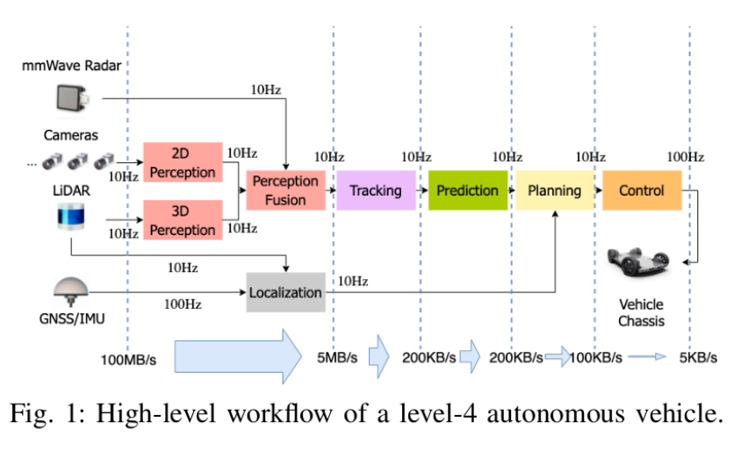
High-level overview of workflow
Each module is a process with multiple threads

Slide 4
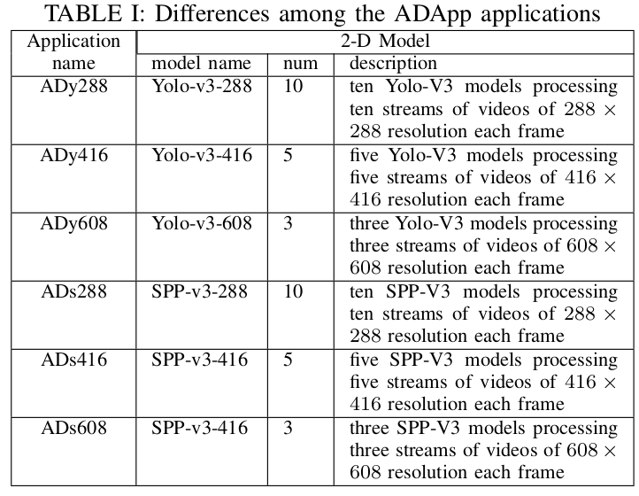
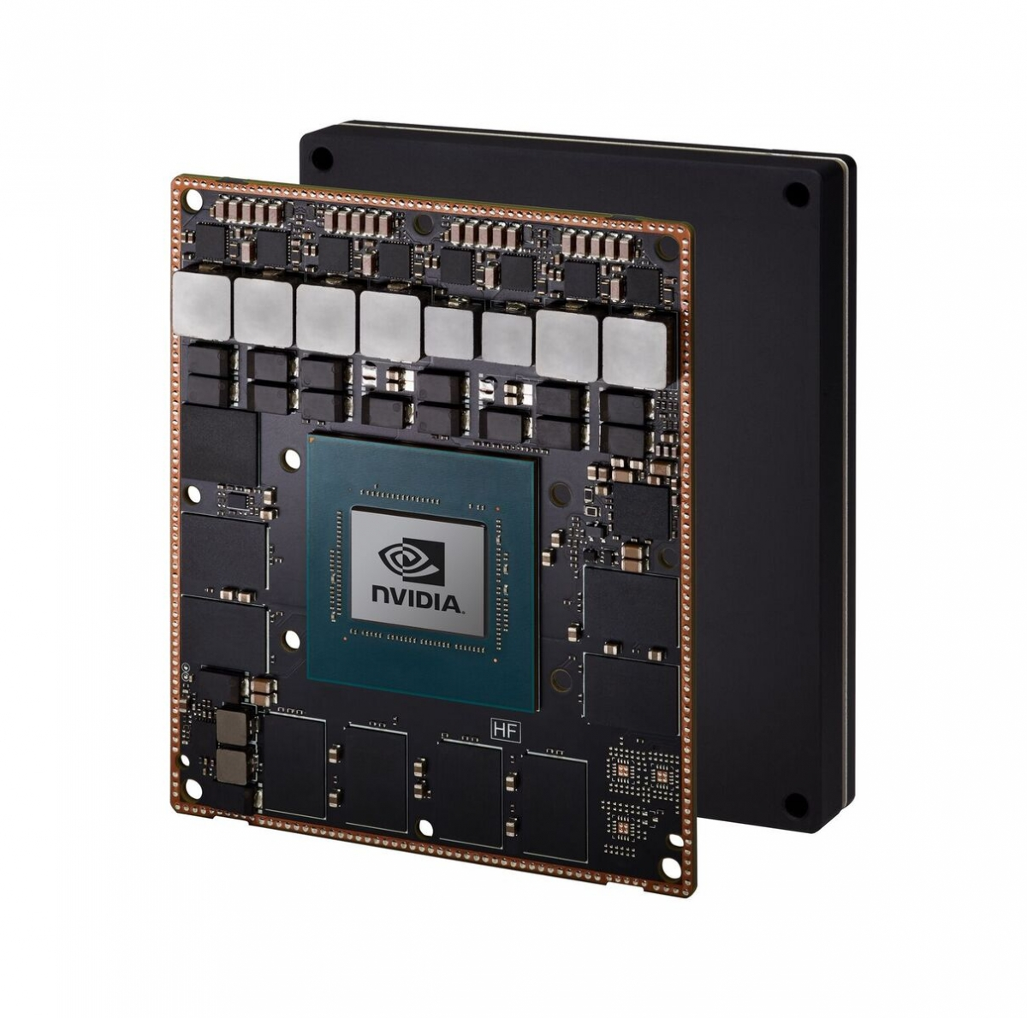
To figure this out ......
Run some performance tests on applications from Autoware.
All apps have similar architecture
Diverse test cases
Different Resolution, Camera #
Different models

Slide 5
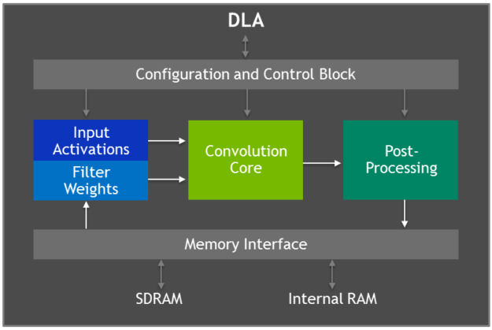
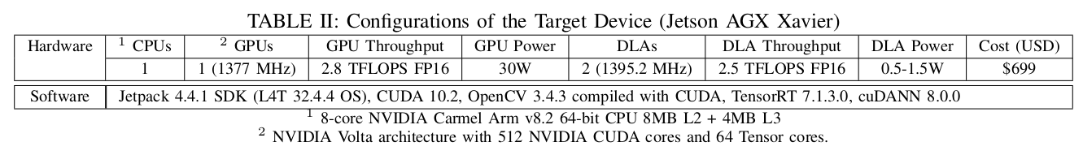
Hardware platform
1* Volta GPU
1* 8-Core ARM v8 CPU
2* NVDLA
1* Programmable Vision Accelerator (Not considered)
- Slower than GPU
- Only focus on: Convolutions, Activations, Pooling and normalization
- Power efficiency
- Free up the GPU to run more complex networks and dynamic tasks*
- Use TensorRT 5.0 to program
- GPU fallback

Slide 6
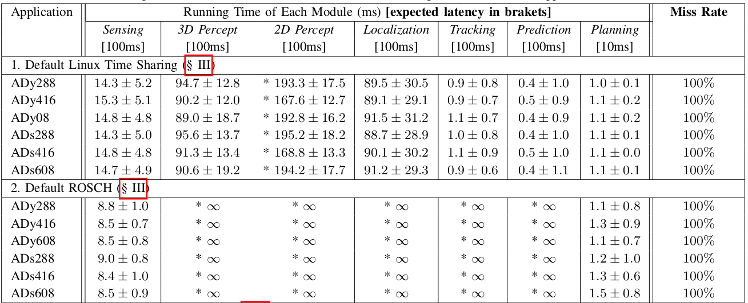
The first test
All missed (the maximum of all modules)
ROSCH (Scheduling algorithm specifically designed for autonomous driving)
The planning module always gives output at a fixed frequency
The perception module is the bottleneck

Slide 7
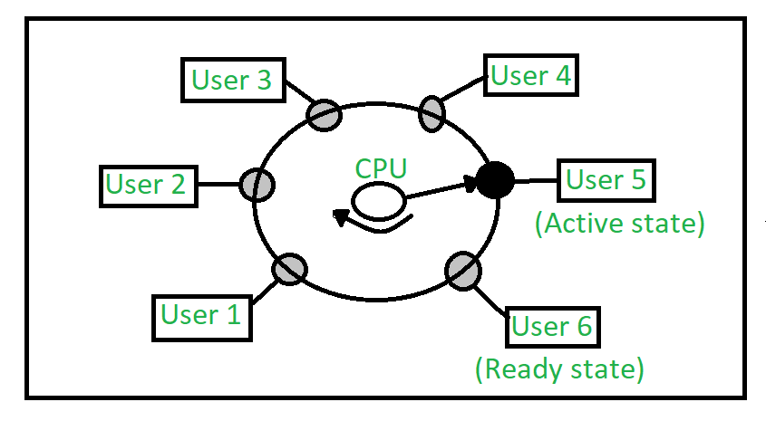
Where is the problem?
For linux: Time-sharing scheduling scheme is not designed for real-time autonomous driving workload
For ROSCH: Starvation happens when prior scheduling schemes are applied to autonomous driving applications running on a low-end device.
ROSCH uses a rank-based scheduling mechanism called Heterogeneous Earliest Finish Time
Priority scheduling: switches tasks only when an event of higher priority needs servicing.

Slide 8


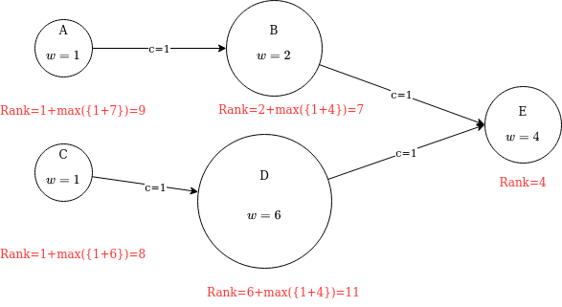
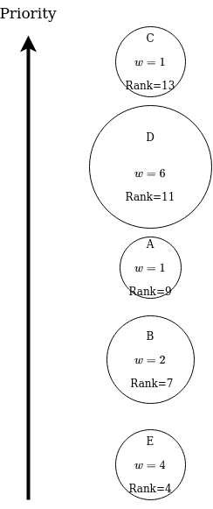
Details about ROSCH

Slide 9
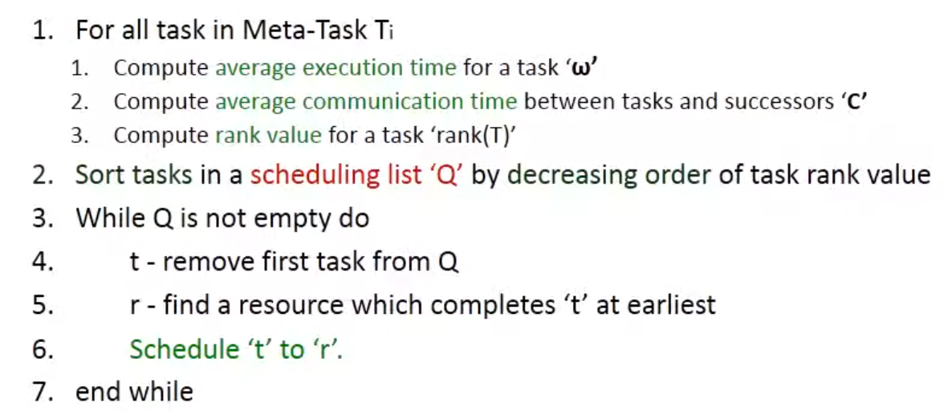
Details about ROSCH
HEFT scheduling.
Ranks are calculated
based on profiling data
Execution still haven’t start. Bind process to CPU.
8. Assign properties to the tasks assigned to the same processor based on their ranks. Higher rank, higher priority.
Actual execution.

Slide 10
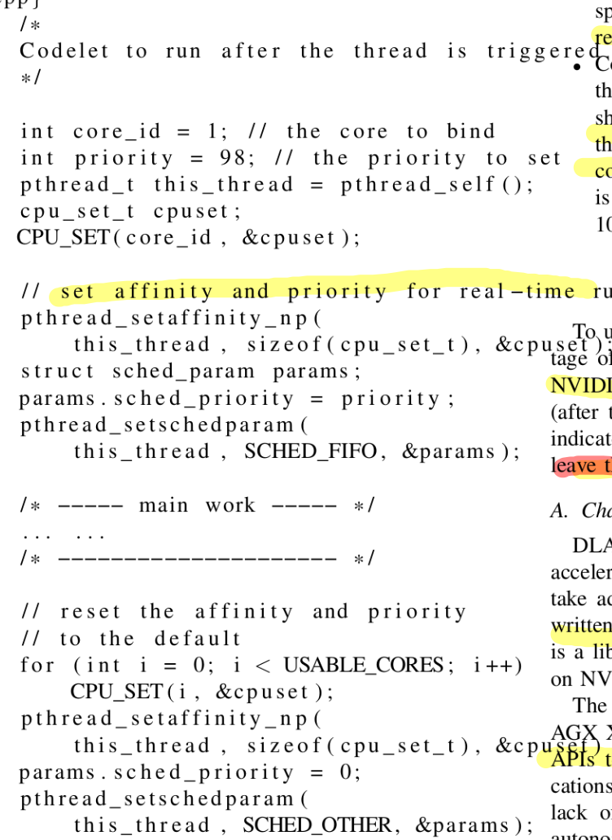
Backup slides for algorithm 1

Slide 11
What causes the starvation?
There are only 6 CPU cores left. (2 cores reserved for planning module)
Many DAG nodes scheduled to the same core
Some cores in the perception module are assigned to the same core as the sensing module
ROSCH gives higher priorities to the sensing nodes than the perception nodes. When perception and sensing are both scheduled to one processor, sensing always has a higher rank.
All threads inherit the priority of a process.
As a result, threads for sensing nodes have higher priorities, hog the CPU core throughout the execution. Perception nodes starve.
If perception nodes starve. Everything depends on perception nodes starve as well.

Slide 12
Solution: Just-In-Time Adjustment
Key observation1: Process with higher rank takes too much time. We need to reduce the time for a node to hold high priority.
Key observation2: Main threads are most important, other threads are non-critical assistant threads.
All threads are set to default priority
When the node has an incoming task to process, the priority of the node’s main thread is set to the HEFT priority and the main thread preempts other threads to execute.
After main thread processing finishes, its priority resets to the system default.

Slide 13
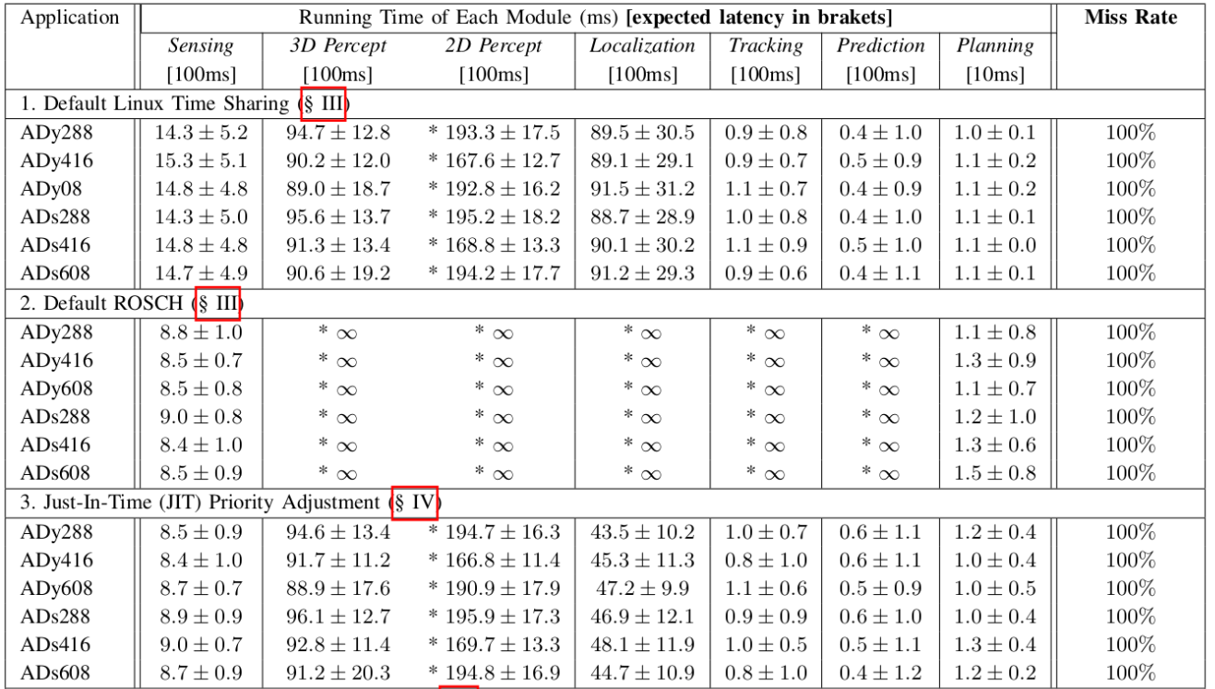
The second test (Performance of JIT)
The starvation issue is gone
Sensing and localization modules show a significant speedup
2D perception and 3 perceptions do not show speedups

Slide 14
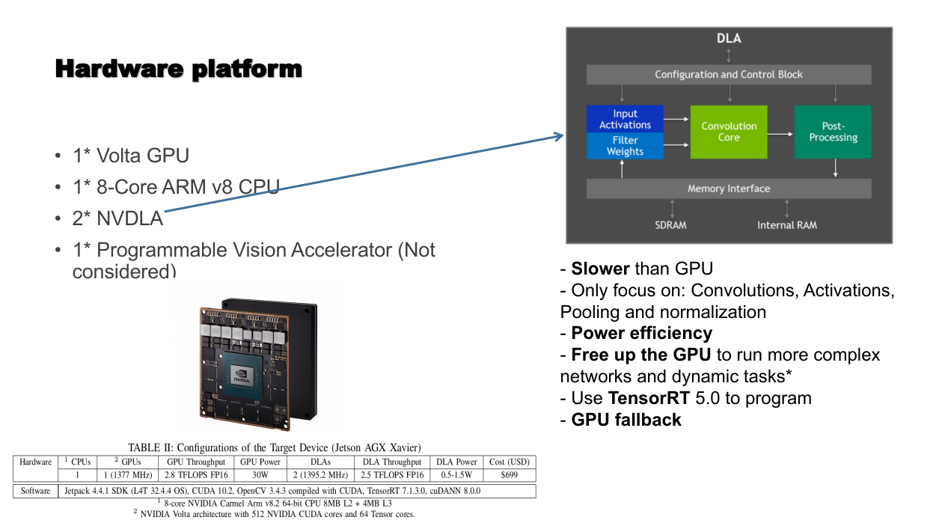
Where is the problem?
Through Nvidia profiler, the authors find DLAs are underutilized.
These applications don’t use the correct TensorRT API.
Potential reason: More development effort to use DLA. The benefits are often less satisfying.

Slide 15
Solution: Expand scheduling algorithm to support DLA
Key observations:
The number of accelerators is very limited
Enumerate all the possible viable assignments of the task nodes to the accelerators.

Slide 16
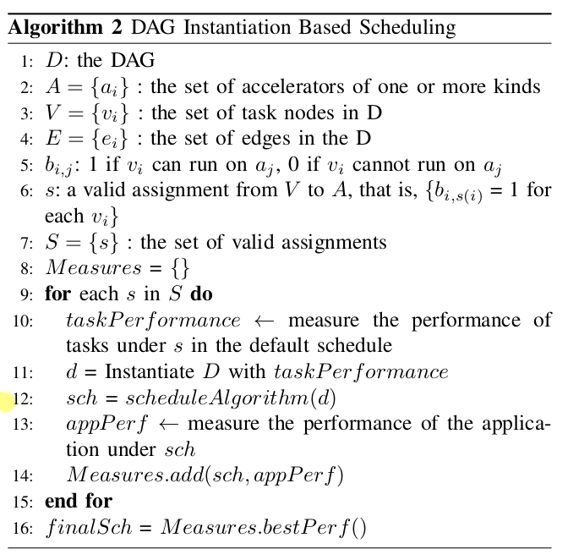
Backup slides for algorithm 2

Slide 17
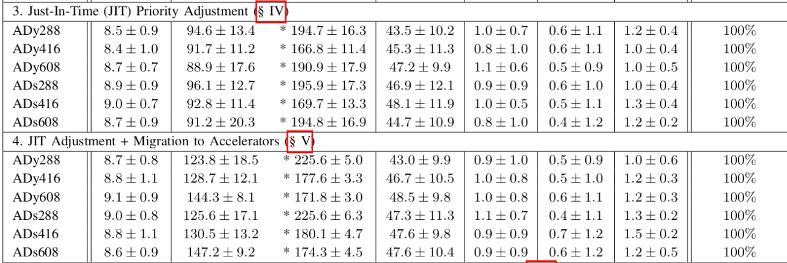
Third test (Performance of using DLA)
Perception performance becomes worse.

Slide 18
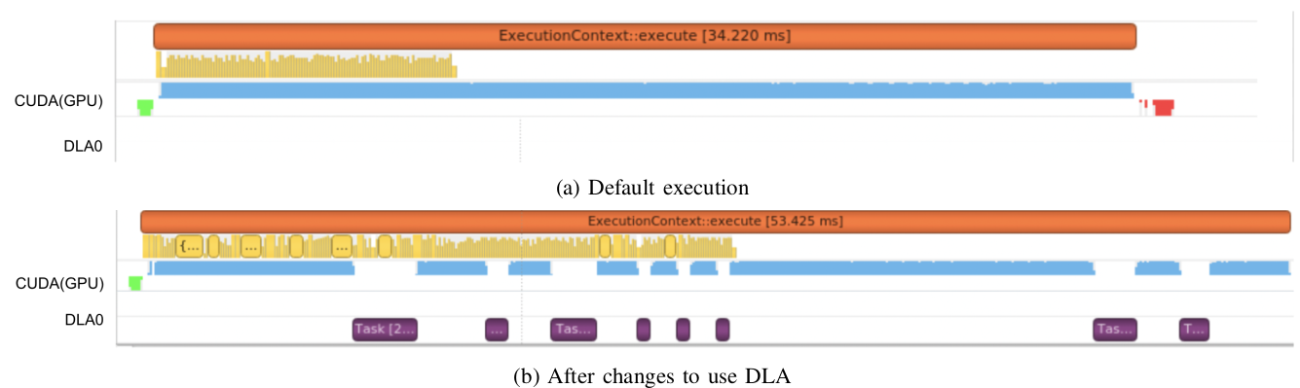
Where is the problem?
When DLA doesn’t support an operator, it fallbacks to GPU.
eg: LeakyReLU falls back at least 57 times when making an inference
Switching between DLA and GPU incurs overhead
The hardware only allows 8 sub-graph. After 8 fallback in an execution, all remaining layers in the DNN have to run on GPU. DLAs are still under utilized.

Slide 19
Solution: Modify the model
Replace leaky-ReLU with Relu.
Training takes longer, but accuracy has no significant loss.
Relu is supported by Tensor RT and DLA

Slide 20
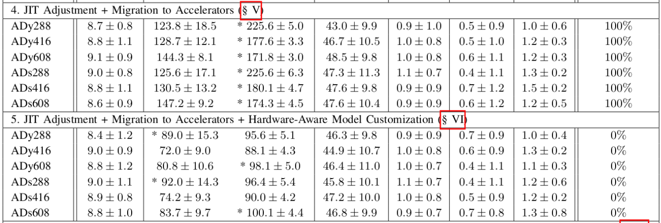
The fourth test (Performance of replacing Relu)
Problem solved. 3D perception sees about 1.5x speedup, 2D sees 2-2.2x speedups
The application meets the real-time requirement

Slide 21
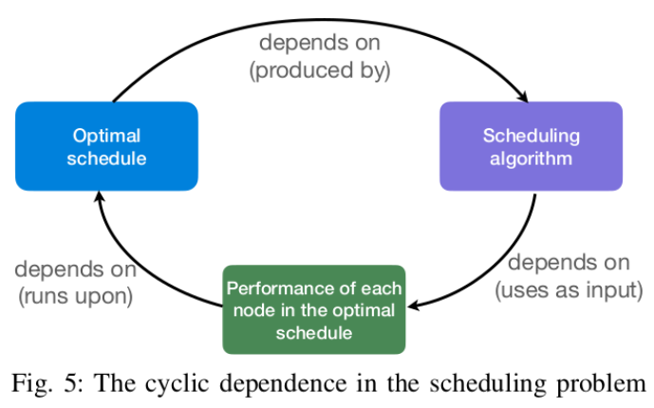
Other attempts
Schedule policy affects performance. Performance
affects generated policy.
Iterative approach:
Starts with measured performance of tasks under
default schedule.
Goes back to the last step, until either schedule remain unchanged (convergence) or the algorithm times out.
Results
The scheduling algorithm already considers all placement opportunities. So this step doesn’t help much.

Slide 22
Conclusions
Proved it is possible to run L-4 autonomous driving on one ship with 0 latency misses.
Revealed performance issues and solutions when deploying L-4 autonomous driving in low-end hardware.
The inefficiency of existing scheduling algorithm on low-end devices
The lack of support for DLA in existing autonomous drving software
The low utilization of DLA hardware due to frequent swapping
Achieved 15x less power consumption.
Revealed resource under-utilization is the key issue to lower the cost of autonomous driving systems.

Slide 23
Conclusions
Suggests new research directions
Architecture design: Since the cost & power consumption can be reduced dramatically, it would be valuable to reexamine the current design in terms of budget allocation for various components, reinforcements of security or reliability .etc
Software design: The changed assumption on cost and computing resources suggest the need for rethinking the design of autonomous driving software in terms of complexity, communication, synchronization, scheduling, and so on.
Optimization: Lots of optimization techniques of complex autonomous driving systems may become less important. How to ensure stability on low-end devices? How to strike an accuracy-power-speed tradeoff on multiple accelerators?

